Slide 1
ENTERPRISE MYSQL PORTFOLIO PROJECT
Vehicle Rental
System
Database: vehicle_rental_db • 4 Tables • 60 SQL Queries • 30,600 Verified Records
Technologies: MySQL 8.0 • MySQL Workbench • Python & SQLite • Git & GitHub
FLEET PASS • UNLIMITED KILOMETERS
SEDANS • SUVS • LUXURY • ELECTRICS • 22 CITIES

Slide 2
1 Project Overview
C
V
L
Customer Management
Stores customer personal details, verified driver license numbers, contact info, city, and registration dates.
Fleet Management
Maintains fleet catalog: model name, manufacturer brand, category (SUV, Sedan, Electric), fuel type, and daily rates.
Location Hub Management
Stores airport hubs, metro branches, physical addresses, contact numbers, and parking bay capacities.
R
A
P
Rental Management
Central transactional ledger recording pickup/drop hubs, rental duration, total amount, and booking status.
Revenue & Fleet Analytics
Analyzes category revenue contribution, fleet utilization, idle vehicles, and highest-earning vehicle models.
Payment & Status Tracking
Tracks multiple payment methods (UPI, Credit/Debit Cards, Net Banking) and statuses (Completed, Active, Cancelled).
Vehicle Rental System | 2

Slide 3
2 Problem Statement & Objectives
!
Problem Statement
O
Project Objectives
Commercial car rental operations manage thousands of customers, hundreds of fleet assets, and multi-hub branches across cities. Without an integrated relational database, severe operational issues arise:
• Inconsistent & duplicated records between fleet inventory and customers.
• One-way drop-offs hard to track between separate pickup and return locations.
• Unidentified idle inventory leading to high capital depreciation.
• No unified visibility into revenue drivers, active rentals, and cancellation rates.
1 Design a normalized relational MySQL schema for vehicle rentals.
2 Enforce strict referential integrity using primary and foreign keys.
3 Populate and verify 30,600 realistic enterprise records across 22 cities.
4 Perform multi-table relational analysis using INNER & LEFT JOINs.
5 Evaluate category performance, customer spend, and payment channels.
6 Implement advanced CTEs & Window Functions for ranking and business KPIs.
Vehicle Rental System | 3

Slide 4
3 Technology Stack
M
W
G
MySQL 8.0+
Relational Database Management System providing enterprise-grade transaction processing, ACID compliance, and modern window analytical functions.
MySQL Workbench
Visual database administration suite used for executing SQL queries, managing constraints, inspecting data tables, and generating ER diagrams.
Git & GitHub
Version control and source code repository hosting all SQL dump scripts, documentation files, ER diagrams, and query modules.
Project Scope & Dataset Scale
• Database: vehicle_rental_db • Tables: 4 (customers, vehicles, rental_locations, rentals)
• Total Dataset Scale: 30,600 verified records across 22 metropolitan cities.
• SQL Analysis: 60 graduated queries across Simple, Medium, and Hard difficulty levels.
Vehicle Rental System | 4

Slide 5
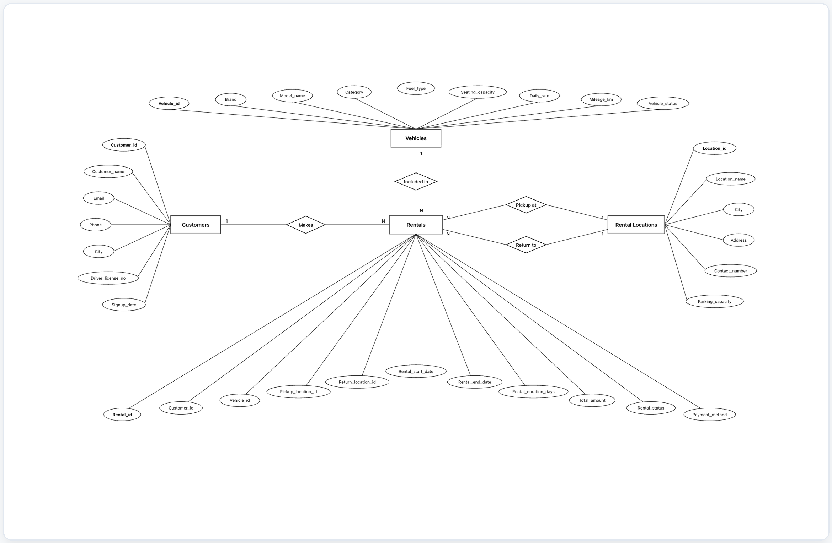
4 Entity Relationship Diagram
Customers ➔ Rentals
One customer can book many vehicle rentals over time (1 : N).
Vehicles ➔ Rentals
One vehicle can appear in multiple bookings across calendar periods (1 : N).
Locations ➔ Rentals
One hub hosts many pickups & returns, supporting one-way intercity trips (1 : N).
Vehicle Rental System | 5

Slide 6
5 Database Schema
customers
vehicles
rental_locations
rentals
customer_id [PK]
customer_name
email
phone
city
driver_license_no
signup_date
vehicle_id [PK]
model_name
brand
category
fuel_type
daily_rate
vehicle_status
location_id [PK]
location_name
city
address
contact_number
parking_capacity
rental_id [PK]
customer_id [FK]
vehicle_id [FK]
pickup_location_id [FK]
return_location_id [FK]
rental_start_date
rental_duration_days
total_amount
rental_status
payment_method
Vehicle Rental System | 6

Slide 7
6 Key Relationships & Data Integrity
1
2
3
CUSTOMERS ➔ RENTALS
rentals.customer_id ➔ customers.customer_id
Enforces that every rental must belong to a registered customer. One customer can have many historical rentals.
VEHICLES ➔ RENTALS
rentals.vehicle_id ➔ vehicles.vehicle_id
Ties every booking to a valid fleet asset. Tracks which vehicles are currently rented or idle.
LOCATIONS ➔ RENTALS
rentals.pickup_location_id ➔ rental_locations.location_id
Supports multi-hub operations where pickup and return stations can differ (enabling one-way rentals).
Data Integrity Rules Enforced
• Primary keys uniquely identify records across all 4 tables with 1:N cardinality.
• Foreign keys prevent orphan rentals; bookings cannot point to non-existent customers, cars, or hubs.
• Data types and constraints enforce currency precision (DECIMAL 10,2) and accurate DATETIME timestamps.
Vehicle Rental System | 7

Slide 8
7 Database Implementation
1
2
3
Step 1: Schema Setup
CREATE DATABASE IF NOT EXISTS vehicle_rental_db;
USE vehicle_rental_db;
Create the isolated database schema and set it as the active working context.
Step 2: Table Creation
CREATE TABLE customers (...);
CREATE TABLE vehicles (...);
CREATE TABLE rental_locations (...);
CREATE TABLE rentals (...);
Create dimension master tables first, then create the central rentals fact table with foreign keys.
Step 3: Verification
SHOW TABLES;
SELECT COUNT(*) FROM customers;
SELECT COUNT(*) FROM rentals;
Confirm table existence, check constraint compilation, and verify referential integrity.
Vehicle Rental System | 8

Slide 9
8 Data Insertion & Verification
D
Data Inserted
V
Verified Record Counts
• 10,000 Customer profiles with realistic names, cities, phone & driver license IDs.
• 500 Fleet vehicles spanning 10 brands (Toyota, Hyundai, Tesla, BMW, Tata, etc.).
• 100 Rental hub stations across 22 major Indian metropolitan cities.
• 20,000 Rental transactions spanning 2024 to 2026.
• Start dates, end dates, duration (1-14 days), and calculated amounts.
• Diverse payment channels (UPI, Credit/Debit cards, Net Banking, Cash).
• Realistic operational statuses (Completed, Active, Cancelled, Reserved).
Executing SELECT COUNT(*) confirms complete data integrity:
customers : 10,000 records
vehicles : 500 records
rental_locations : 100 records
rentals : 20,000 records
Total Verified Records : 30,600 records
Vehicle Rental System | 9

Slide 10
9 SQL Analysis — Basic Queries
S
Simple Queries (Q1 – Q20)
-- Q7. Display vehicles in the 'SUV' category
SELECT model_name, brand, daily_rate
FROM vehicles
WHERE category = 'SUV'
LIMIT 3;
-- Q18. Top 10 highest-value rentals
SELECT rental_id, customer_id, total_amount
FROM rentals
ORDER BY total_amount DESC
LIMIT 10;
-- Q20. Total revenue from completed rentals
SELECT SUM(total_amount) AS total_revenue
FROM rentals
WHERE rental_status = 'Completed';
-- Output: ₹22,10,04,935.00
• SELECT, WHERE, LIKE, DISTINCT
• ORDER BY, LIMIT
• COUNT(), SUM(), AVG(), MIN(), MAX()
• Filters by city ('Mumbai', 'Bangalore')
• Filters by category ('SUV') and brand ('Toyota')
• Filters by rental_status ('Completed')
• Payment method filtering ('UPI')
Vehicle Rental System | 10

Slide 11
10 Revenue & Rental Analysis
-- Revenue & volume by vehicle category
SELECT v.category,
COUNT(r.rental_id) AS total_rentals,
SUM(r.total_amount) AS total_revenue
FROM vehicles v
JOIN rentals r ON v.vehicle_id = r.vehicle_id
WHERE r.rental_status = 'Completed'
GROUP BY v.category
ORDER BY total_revenue DESC;
/* Key Findings:
* SUV: ₹7.14 Cr (32.3%)
* Luxury: ₹6.51 Cr (29.5%)
* Electric: ₹4.26 Cr (19.3%) */
R
Commercial Value & SQL Concepts
What it answers: Which vehicle classes generate the largest revenue share and rental frequency?
SQL Concepts used: INNER JOIN, GROUP BY, SUM(), COUNT(), ORDER BY DESC.
Business Value: Shows that SUVs & Luxury cars generate over 61% of total enterprise revenue, justifying targeted fleet expansion.
City Performance: Metros like Pune, Bangalore, Mumbai, and Delhi lead in completed rental transaction value.
Vehicle Rental System | 11

Slide 12
11 Customer & Fleet Analysis
C
Customer Rental Analysis
P
Payment Method Analysis
-- Total rentals by each customer
SELECT c.customer_id, c.customer_name,
COUNT(r.rental_id) AS total_rentals
FROM customers c
LEFT JOIN rentals r ON c.customer_id = r.customer_id
GROUP BY c.customer_id, c.customer_name;
• LEFT JOIN ensures registered customers who have made 0 bookings are preserved for re-engagement marketing.
• Identifies high-frequency repeat renters (4+ bookings) for loyalty rewards.
-- Average rental amount by payment method
SELECT payment_method,
COUNT(*) AS total_transactions,
ROUND(AVG(total_amount), 2) AS avg_amount
FROM rentals
GROUP BY payment_method;
• UPI represents the largest transaction volume (~38%), while Credit Card transactions lead in average ticket value for premium bookings.
• Compares completed vs cancelled transactions.
Vehicle Rental System | 12

Slide 13
12 Business Questions Answered
V
Vehicles
C
Customers
L
Locations
• Highest-revenue model
• Most-rented fleet model
• Vehicles never booked
• Category price leaders
• Top spending customers
• Repeat renters (4+ bookings)
• Above-average spenders
• City-wise customer ranks
• Busiest pickup stations
• Top revenue branches
• Intercity one-way drop trends
• Capacity utilization
R
Rentals
P
Payments & Status
T
Trends & Time
• Peak duration trips
• Budget/Standard/Premium tiers
• High-value transactions
• Yearly/monthly volume
• Payment channel share
• Completed vs Cancelled ratio
• Average ticket per method
• Transaction security
• Revenue share per category
• Year-over-year bookings
• Seasonal surge analysis
• Active rental monitoring
Vehicle Rental System | 13

Slide 14
13 End-to-End Project Workflow
1
2
3
4
5
6
Design Database
Model 4 relational tables, define PK/FK relationships & cardinalities.
Create Tables
Execute DDL schema in MySQL with constraints & data types.
Insert Data
Populate 30,600 verified records simulating commercial fleet operations.
Verify Records
Run SHOW TABLES and record count queries to guarantee integrity.
SQL Analysis
Execute 60 queries across Simple, Medium, and Hard difficulty levels.
Business Insights
Extract operational KPIs, revenue trends, and customer metrics.
Implementation Flow
Create Database ➔ Create Related Tables ➔ Insert Bulk Data ➔ Verify Data Counts ➔ Execute SQL Analysis (Simple ➔ Medium ➔ Hard) ➔ Generate Actionable Business Insights
Vehicle Rental System | 14

Slide 15
14 Results & Key Outcomes
D
Database Outcome
A
Analysis Outcome
T
Technical Skills
✓ 4 Normalized relational tables
✓ Primary & Foreign Key relationships
✓ One-to-many (1:N) links enforced
✓ Rentals tied to customers, cars & hubs
✓ Zero orphan or invalid transactions
✓ 60 SQL analysis practice queries
✓ Rental duration & volume analysis
✓ ₹22.1 Cr revenue attribution breakdown
✓ Vehicle category market share
✓ Customer lifetime value & payment share
✓ Multi-table INNER and LEFT JOINs
✓ GROUP BY and HAVING filters
✓ Common Table Expressions (CTEs)
✓ Window Functions (ROW_NUMBER, DENSE_RANK)
✓ PARTITION BY ranking logic
Vehicle Rental System | 15

Slide 16
15 Future Enhancements
1
2
3
4
5
GPS Live Telematics
Real-time fleet tracking and automated geofencing.
Dynamic Surge Rates
Demand-driven weekend and holiday automated pricing.
Maintenance Logs
Track vehicle service history, oil changes & fitness tests.
Insurance Add-ons
Zero-depreciation and third-party protection policies.
Loyalty Rewards
Frequent-renter milestone points and corporate discounts.
6
7
8
9
10
EV Battery Telemetry
Battery charge tracking and charging station routing.
Damage Audit Logs
Pre-trip and post-trip digital damage checklist audits.
Mobile App Keys
Contactless smartphone Bluetooth vehicle unlocking.
Chauffeur Services
Option to book professional vetted drivers on-demand.
AI Fleet Allocation
Predictive algorithm reallocating idle cars to high-demand hubs.
Vehicle Rental System | 16

Slide 17
16 Conclusion
What This Project Demonstrates
The Vehicle Rental System successfully demonstrates end-to-end relational database design, data integrity enforcement, and practical SQL engineering applied to fleet management. It models 30,600 verified records across 4 interconnected tables and executes 60 graduated analytical queries that convert raw bookings into actionable business intelligence.
K
Key Learning Summary
Relational Schema Modeling • Referential Integrity • Multi-Table JOINs • Grouped Aggregations • Window Functions • Business KPI Analytics
T
Technologies Mastered
MySQL 8.0 • MySQL Workbench • Python & SQLite Runner • Git / GitHub • SQL Query Optimization & Business Analytics
Vehicle Rental System | 17

Slide 18
Thank You
Questions & Discussion
Vehicle Rental System — MySQL Relational Database Project
FLEET PASS • UNLIMITED KILOMETERS
SEDANS • SUVS • LUXURY • ELECTRICS • 22 CITIES

